Slide 1
Marketing and Sales Story
LP Pressure Washing | 9/14/2023

Slide 2
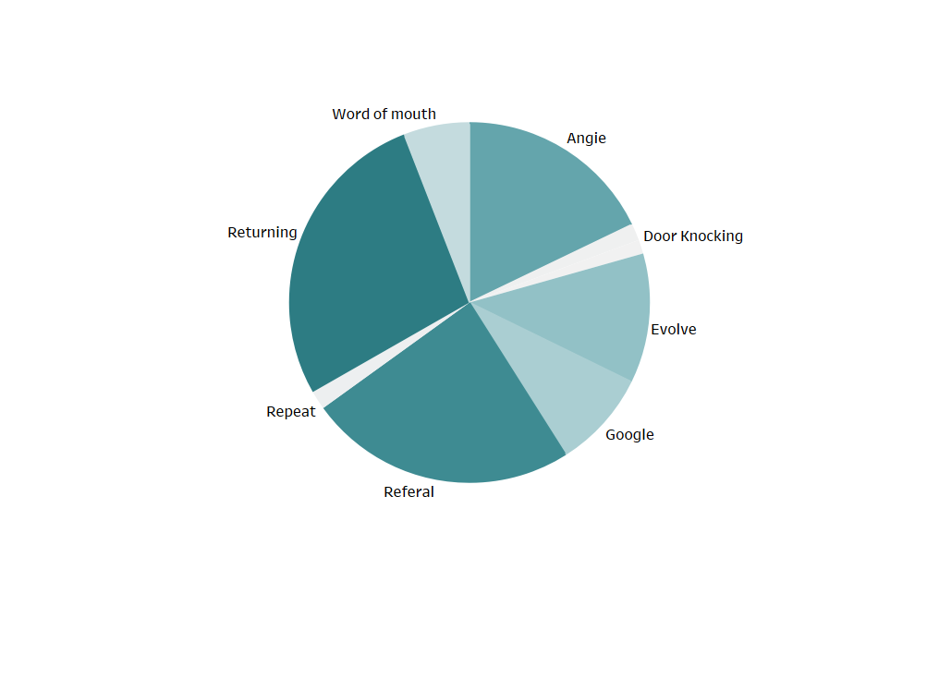
Revenue Avenues
We can see that quarter of our income below is from returning clients. And almost another quarter is from referrals.

Slide 3
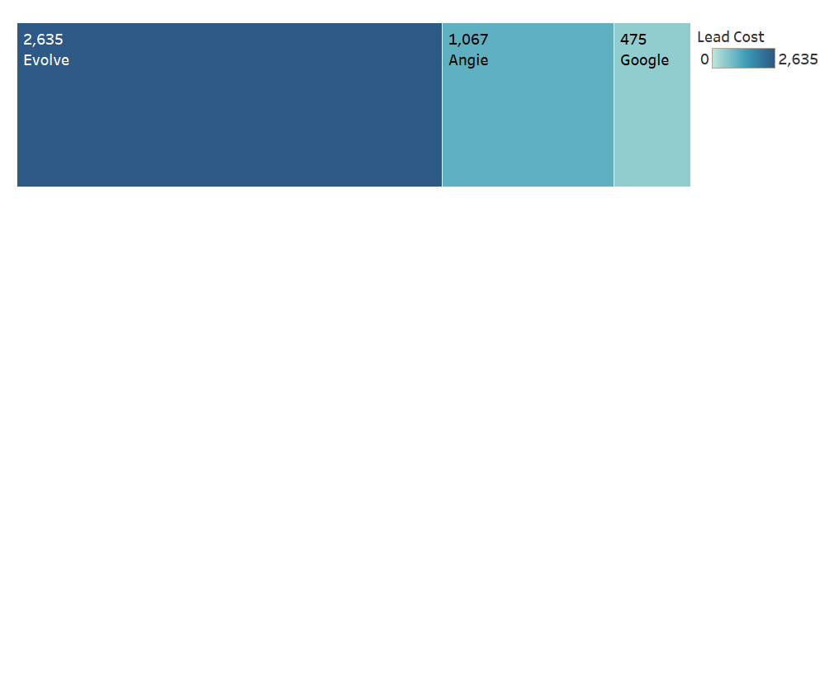
Paid Marketing Tools
Paid marketing tools take up most of the other half. The biggest is from Evolve which did Facebook ads for us.

Slide 4
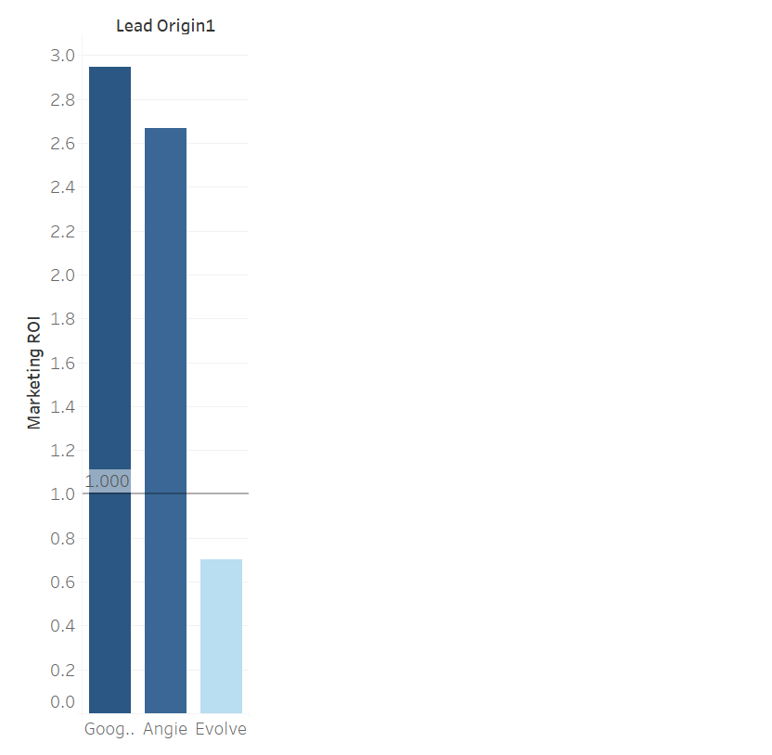
ROI of Marketing Tools
The ROI of Google and Angie are around 3.0 which is decent. However, Evolve is doing terribly at a negative return. We lost money using Evolve this past year.

Slide 5
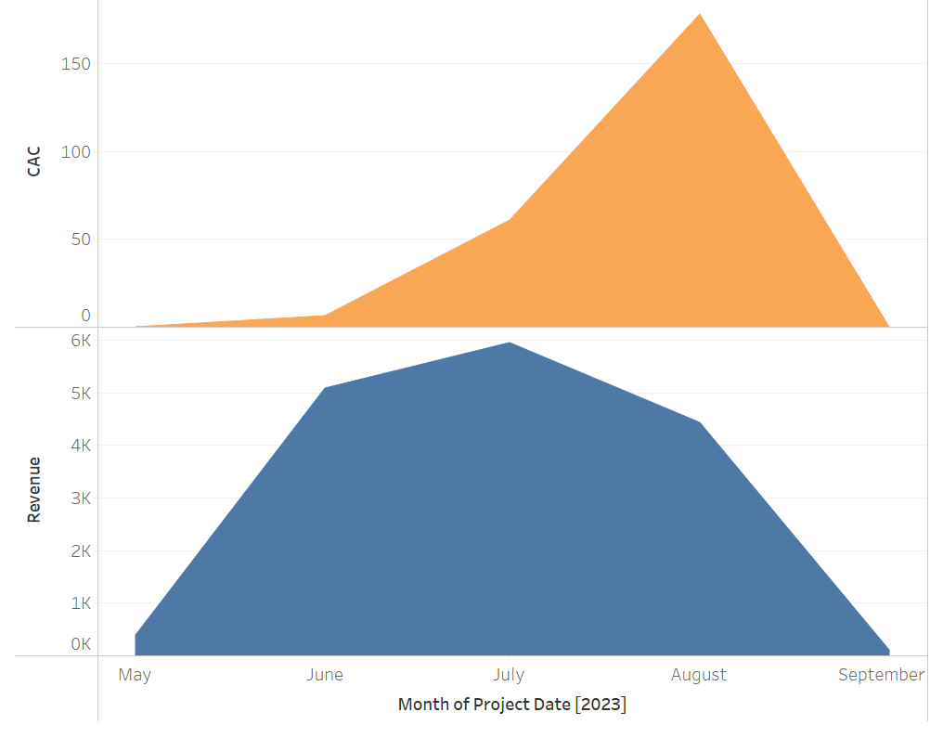
CAC and Revenue
In the orange is the CAC or Customer Acquisition cost. It was the highest in the month of August. This was due to paying a large fee to Evolve. In the blue we can see the Revenue over the summer. July is the highest month. This is due to having the entire month to work. Where in June and August we only had about 2 weeks of work.

Slide 6
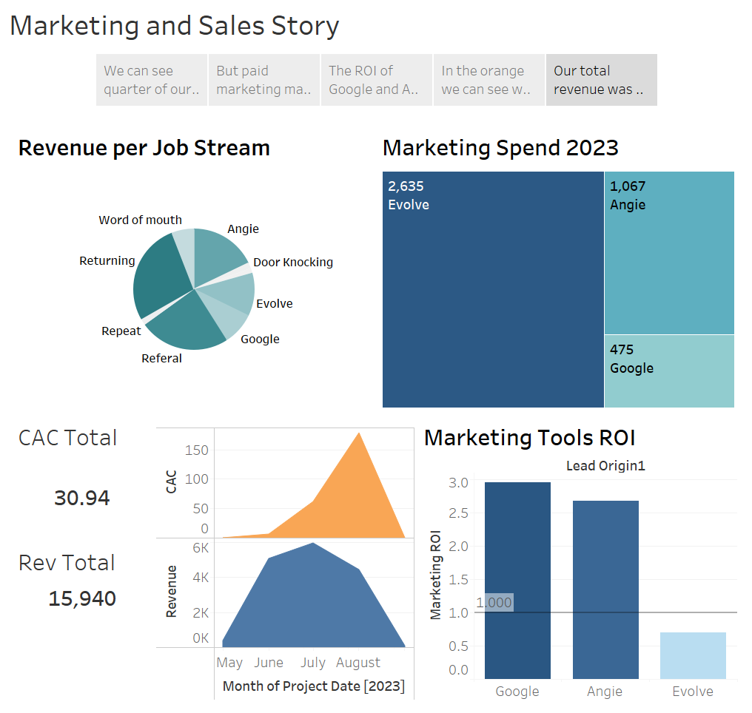

Slide 7
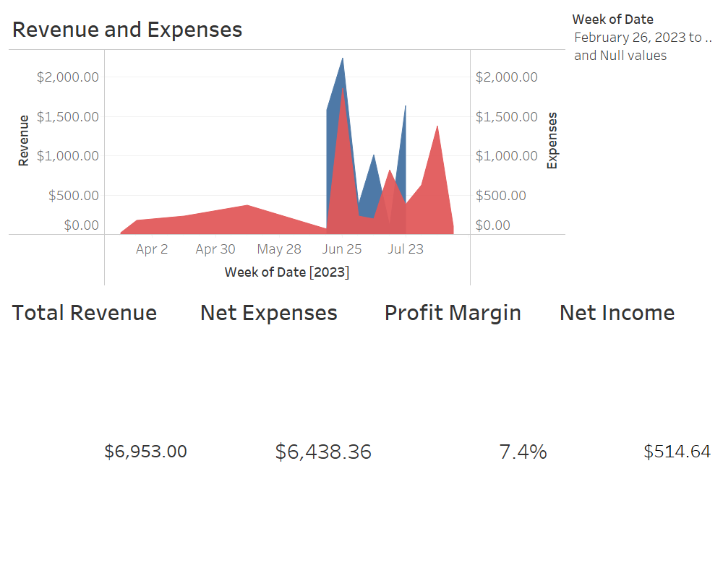
Accounting Dashboard
We had several start up costs in the spring. Profit margin is after expenses only. We end with only 7.4% which is low.

